Slide 1
Covex OTS
Execution Checklist: Things to be Mindful of

Slide 2
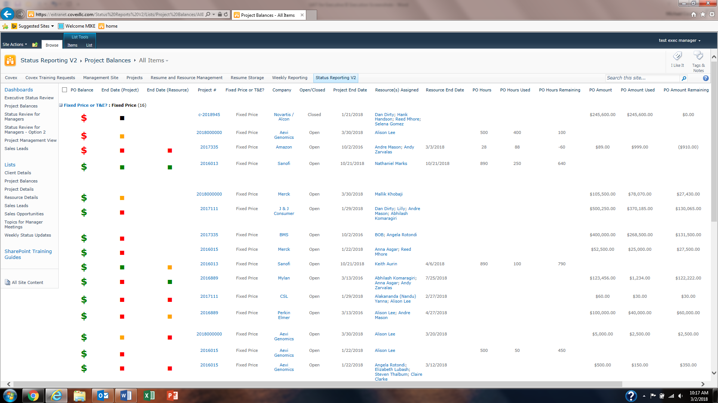
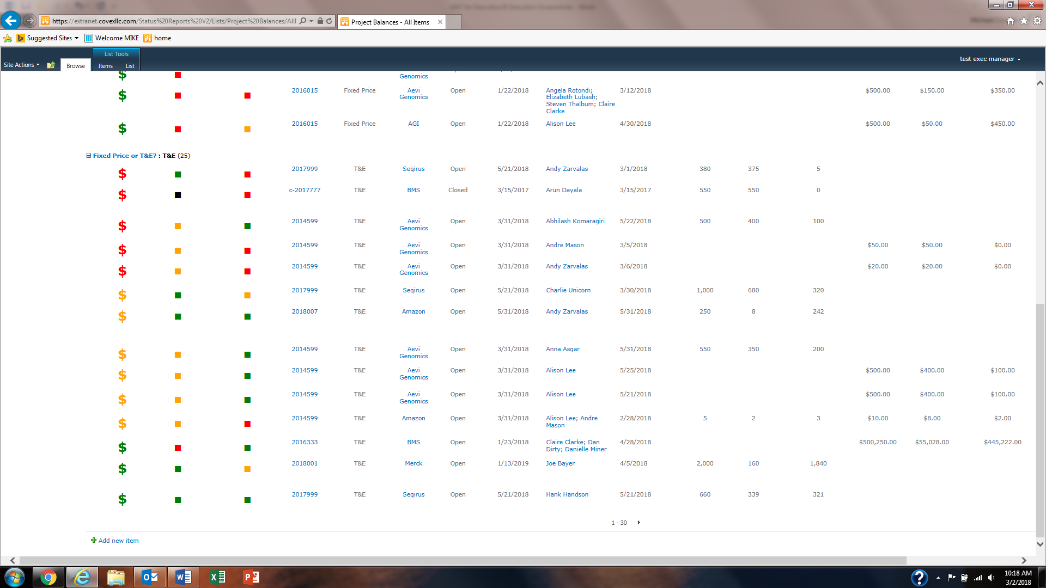
Screenshots
1. When capturing a screenshot make sure it captures all of the essential information that is stated in the Expected Results.
Be sure they are GOOD screenshots, which means they overlap from what was captured on the previous page.
Make sure to capture the Date / Time on the desktop.
Below is an Example of how to properly overlap screenshots:

Slide 3
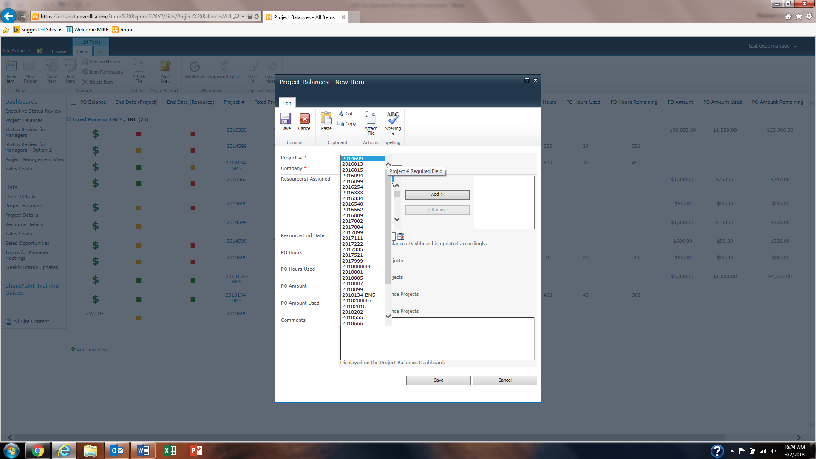
Proper Labeling of Screenshots
1. Include the section (if necessary), the Step #, and the Page #.
If there is more than one page label it as follows: X of Y.
An example of how to properly label a screenshot:
Section 1.1 – Project Balance
Test Step: 7
Page 1 of 1

Slide 4

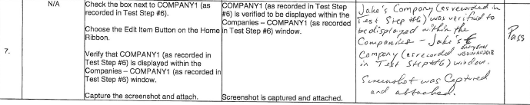
GDP (Good Documentation Practices)
GDP – describes the standards by which documents are created and maintained.
1. Please write as legibly as possible – NEAT and TIDY is the way to be.
Use indelible ink (blue or black) – NO GEL PENS & NO PENCIL.
NOTE* – If you overwrite anything, even a LETTER, cross it out and mark it as an ENTRY ERROR
Example of an Overwrite:
Example of Proper GDP: Reason, Initials, & Date

Slide 5
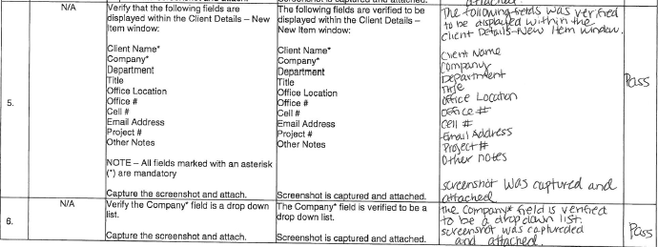
Be sure to write in the PAST TENSE
Is = Was
Are = Were
Below both past and present tense were recorded in the Actual Results, which should never occur. It is always PAST TENSE.

Slide 6
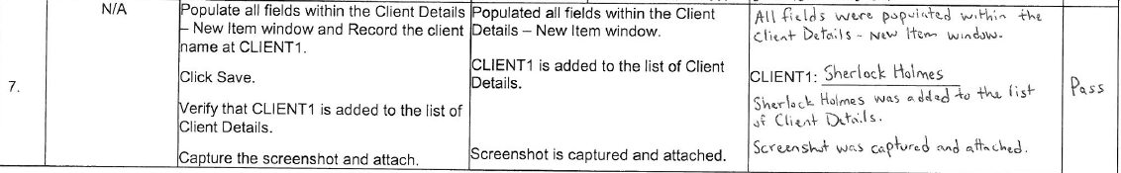
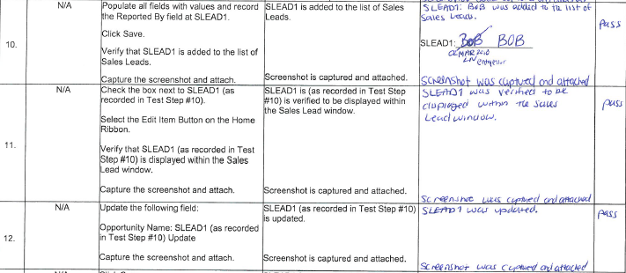
Parameters in the Test Setup Data & Recorded Data
Use the exact wording recorded in the Test Setup Data, or what was recorded within the Test Script for the Actual Results.
Below demonstrates the correct way to record data:
The Tester recorded CLIENT1 within the Test Script and then continued to document the Actual Results that displayed.
Incorrect way to record data:
The Tester recorded SLEAD1 and then did not record the Actual Results that displayed, which was BOB.

Slide 7
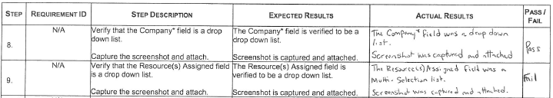
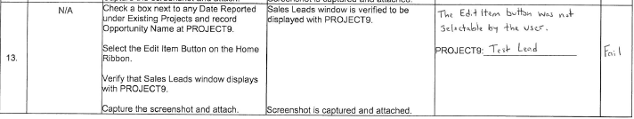
Pass / Failure of a Step
1. In order for a step to PASS, it must match the Expected Results completely.
a. Minor errors: Spelling errors, incorrect wording, & missing words (document errors, but it should not effect the step from passing)
2. If the ACTUAL Results deviate from the EXPECTED Results the step would FAIL, but only after consulting with the Test Lead.
a. A failure results in the need for a written defect by the author.
b. By not consulting with the Test Lead, a defect could PAUSE, or halt an execution where a day of work is then wasted.
Below would constitute an actual FAILURE because it was in fact not a drop down list.
NOTE* – The Actual Results were recorded as it was displayed.
Here the Tester never consulted with the Test Lead and a simple refresh of the page could have prevented this FAILURE.

Slide 8
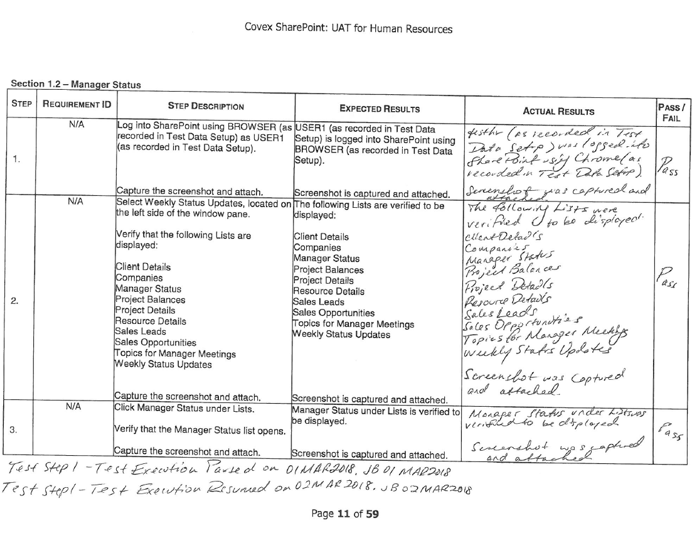
Pausing an Execution
Document on the bottom of the test script exactly when it was paused and resumed.
a. This allows for no discrepancy with screenshots and the length of time in between.

Slide 9
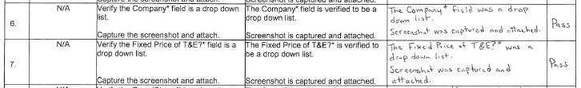
Additional Examples of Test Script Errors: Missing Words
Below a field is being verified that it is a drop down list in both Steps #6 & 7. However, in Step #7 the Expected Results & Actual Results is missing the word “field”.
1. When recording the Actual Results it is necessary to write everything that was displayed.

Slide 10
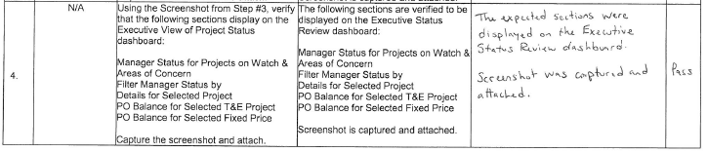
Additional Examples of Test Script Errors: Excluding Words
In Step #4, “Project” is missing in all columns after “Fixed Price”. This is not only a Test Script Error, but a Tester Error.
1.This should have been picked up on during Peer Reviews, or Dry Runs, but not Post Execution Review.

Slide 11

Additional Examples of Test Script Errors: Incorrect User
Expected Results states that USER2 is logged out of SharePoint. However, it is USER1, or testem who is logged into the system.
1. This also should have been addressed prior to execution during Peer Reviews and Dry Runs. However, the Tester accurately recorded what was displayed within the system.

Slide 12
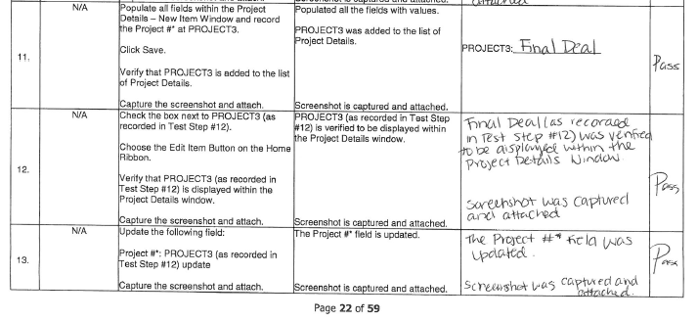
Additional Examples of Test Script Errors: Incorrect Step #
PROJECT3 was recorded at Test Step #11. However, in the preceding steps, it was incorrectly labeled as Test Step #12.
1. This should have been caught and corrected prior to execution. Even the tester continued to record the incorrect Test Step #.
2. Also, nothing was noted as a test script error by the Tester.

Slide 13

Questions?
COVEX, LLC

